Slide 1
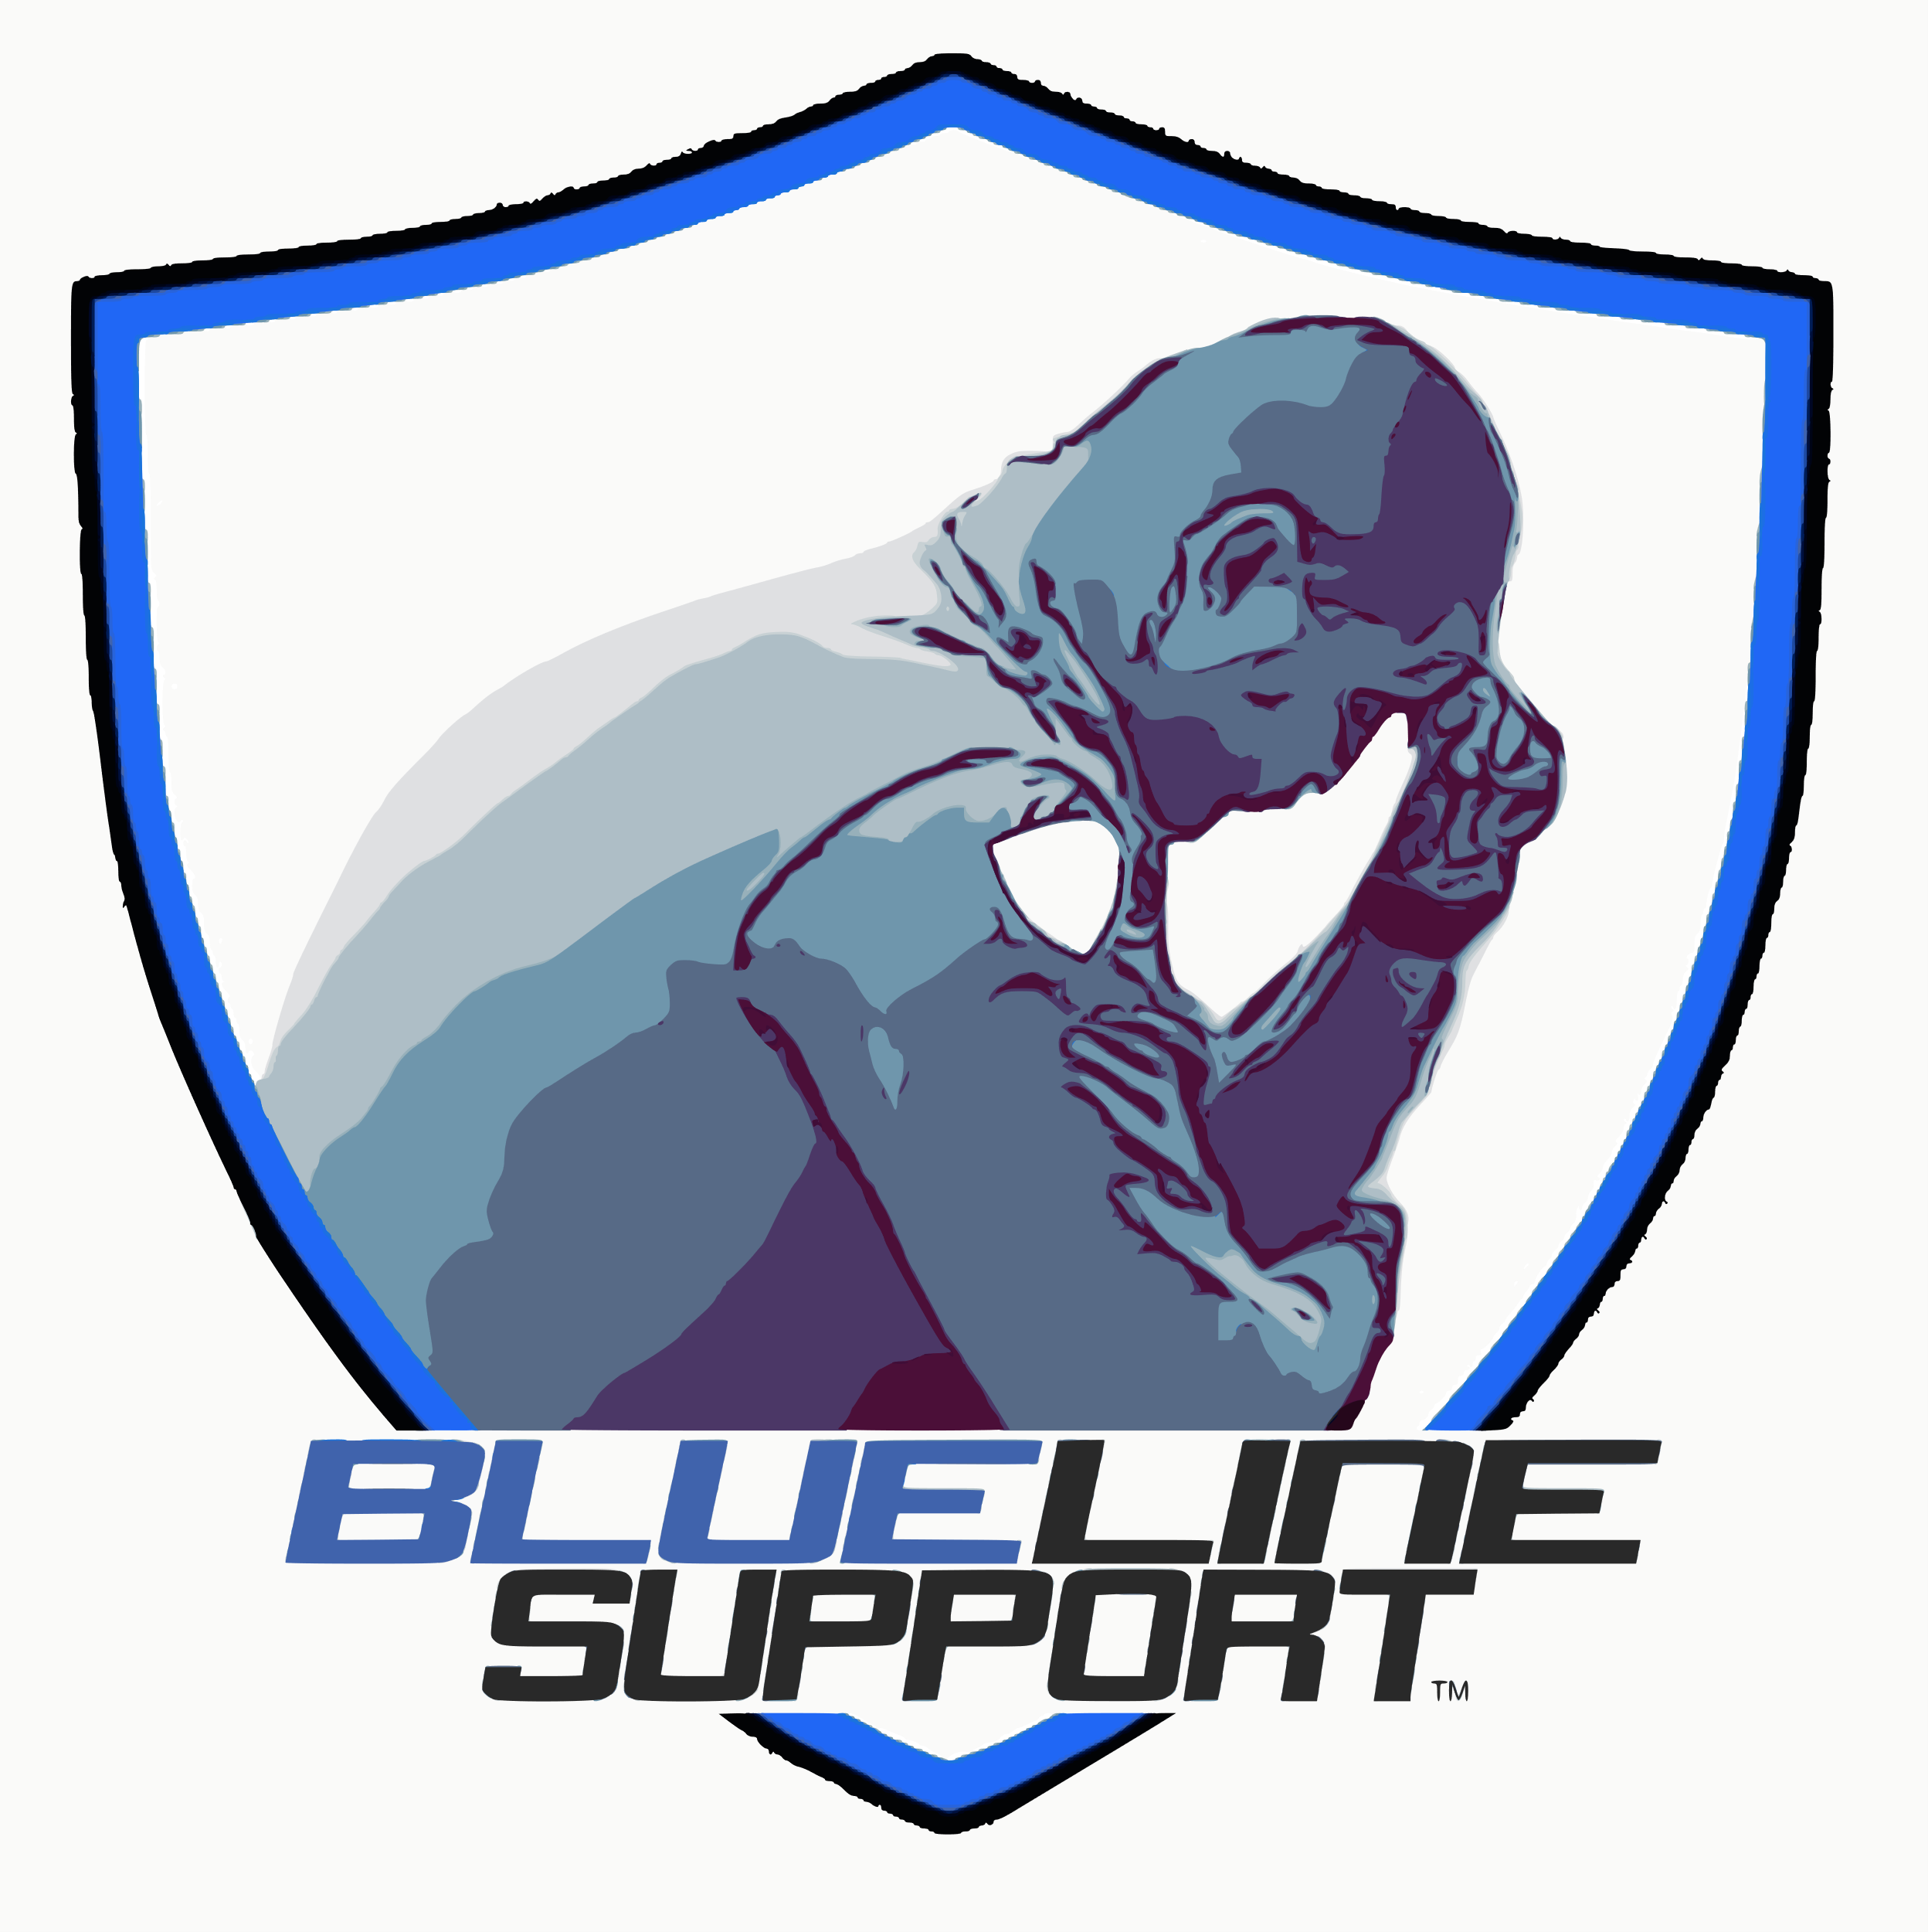
Peer-to-Peer (P2P) Support Training
855-964-2583
https://bluelinesupport-bls.org/
Office: 407-673-3773
david@L-SF.com

Slide 2
Purpose of Training
Discusses relevant ethical issues related to peer support.
Review the use of various interpersonal skills.
Discuss signs and symptoms of various problem areas troubled officers may present.
Discuss stress, stress management, and self-care.
Answers basic questions that may come up in your role as a peer supporter…
Role-play various Peer-to-Peer interactions.

Slide 3
P2P Training
Introduction to Training
Interpersonal Communication Skills
Break
Stress in Law Enforcement
Post-Traumatic Stress
Break & Lunch
Role-playing
Self-Defeating Behaviors
Addressing Loss & Bereavement
Break
Suicide in Law Enforcement
Role-playing
Resources for Peer Support
Training Feedback & Recommendations
Wrap-up

Slide 4
Interpersonal Skills for Peer Support
Communication Skills
Relating Skills
Listening Skills
Responding Skills

Slide 5
Reflections – Interpersonal Skills for Peer Support
How would you assess your communication skills? What are your strengths and weaknesses?
How would you assess your relating skills? What are your strengths and weaknesses?
How would you assess your listening skills? What are your strengths and weaknesses?
How would you assess your responding skills? What are your strengths and weaknesses?

Slide 6
Communication Skills
Mirroring
Reflection back
Paraphrasing
Mirroring affirms you hear the officer
Validation
What is being said makes sense
Does not mean you agree
Validating affirms you hear the officer
Empathy
Imagining the feelings of the officer
Notes:
Mirroring – “What I hear you saying…”
Validation - “I can see that…”
“It makes sense to me that…”
“I can understand that….”
Empathy – Can be healing
“I imagine that you are feeling…”
“I understand that you feel…,”
Confirm what CO is feeling: “Is that what you are feeling?”
What are the main components in establishing a good relationship with a client?

Slide 7
Relating Skills
Putting the officer at ease
Do not dominate the conversation.
Care for Your Fellow Officers
The welfare of the officer is predominate.
Be Respectful
Confidentiality
Officer should make own decisions
No joking
Be Accepting
Creates trust & rapport
Be aware of personal biases
The more you listen the less judgmental & critical you may be.
Be Understanding
Be aware of your verbal & non-verbals
Use analogies of your own experience
Imagine yourself in the officer’s shoes
Notes:
Putting the CO at ease
“Hello, my name is ________. Before we begin, I want you to know that I am a trained, volunteer peer support officer for the “WOI's BLueLine Support”. I want you to know that our discussions are confidential. Do you have any questions?”
“Is coming to talk to me difficult for you?”
“How are you doing right now?” I
“What brings you here today to talk to me?”
“How can I help you?" “What can I do for you?”
Care for Your Fellow Officers:
You are here to help
You respect, accept, and understand the person with whom you are working.
Respect:
Allow the client the right to express personal feelings, ideas, and attitudes.
Allow the client to make personal decisions and to find solutions to problems.
Respect and protect the client’s privacy.
Avoid jokes that poke fun at the client.
Be Accepting
What are your beliefs about marital infidelity?
Do you see it as immoral?
What do you think of a person who goes bankrupt?
Do you think it’s irresponsible?
Do you have any prejudices towards any particular racial or ethnic group or towards gays or lesbians?
Do you see alcoholics as people who lack willpower?
“How were you feeling when that happened?”
“How are you feeling about the experience now?”
“What was going on in your life that led to your having an affair?”
Be Understanding
Imagine yourself in the CO’s shoes
CO at ease:
Do not dominate the conversation.
Observe the emotional state of the CO.
Note the verbal & non-verbal cues
Care:
You are here to help
You respect, accept, and understand the person with whom you are working.
Respect:
Allow the client the right to express personal feelings, ideas, and attitudes.
Allow the client to make personal decisions and to find solutions to problems.
Respect and protect the client’s privacy.
Avoid jokes that poke fun at the client.
Be Accepting:
See questions on slide.
Be Understanding:
Imagine yourself in the CO’s shoes

Slide 8
Listening Skills
Pay attention to what is being said.
Pay attention how it’s being said.
Acknowledge what you are hearing.
Make good eye contact vs. training.
Soften your eye contact.
Notes:
Be aware that there may be a discrepancy between what is being said and how it is said.
Acknowledge: “I see,” “I understand.”
“Seek first to understand and then to be understood.” Stephen Covey – 7 Habits of Highly Effective People
What are the most important ways that you can demonstrate that you are listening to your client?
Would there ever be a time when it would be appropriate to interrupt a client who is talking about a particular problem? When and how?

Slide 9
Responding Skills
Identify the important underlying problems.
Ask open-ended questions.
Avoid asking questions starting with "Why." Better to ask "what" or "who“ or “how”
Do not reassure everything is going to be ok.
Reflect on what you have heard the officer say.
Do not make assumptions.
No responsibility for solving the officer’s problems.
Do not give advice – Provide support.
Notes:
Ask open-ended questions.
Ask about feelings.
“That sounds like a very difficult situation for you to be going through right now.”
“I can see how upsetting this is for you right now.”
“How do you feel about this happening to you?”
With your responses, you want to elicit as much information and emotion from clients as possible.
Ask open-ended questions.
Avoid asking questions starting with "Why." Better to ask "what" or "why.“
Would it ever be helpful to a client to analyze or interpret his/ her problems? What can you do instead?
Would there ever be an appropriate time when it would be helpful to reassure a client that everything they are going through will turn out favorably? What alternatives do you have?
Role Play
Problem 1: A female officer, who has recently returned to work after a maternity leave, asks if she can speak to you. She tells you that she has been grumpy and irritable, and just doesn’t feel like her normal self. What basic need might underlie her complaint? How might you help her explore this?
Problem 2: A fellow officer tells you that he is upset that he has not been able to get any overtime. He appears anxious and agitated. What basic need might underlie his complaint? What questions would help him clarify his feelings?
Problem 3: A newly transferred officer tells you that she feels isolated from her colleagues. She feels people are shunning her because of rumors of her past performance. What basic need might underlie her complaint? How can you help her identify possible solutions?

Slide 10
Multigenerational Workforce
.

Slide 11
Boomers
1946-1965
Gen X
1965-1976
Gen Y Millennials
1977-1995
Gen Z Zoomers
1996-2005
Individualistic
Engaged
Respect and appreciation
Pragmatic and skeptical
Disengaged
Work-life balance
Enthusiastic and self-confident
Collaborative
Socially conscious
Independent
Work ethic
Innovative
Digital natives
Practical
Diverse
Empathetic
Independent
Generational Differences - Workplace
Cline, L.L. (2022, February 22) Generational Difference in the Workplace. Oklahoma State University. lauren.l.cline@okstate.edu

Slide 12
Generational Differences - Values
Boomers
1946-1965
Gen X
1965-1976
Millennials
1977-1995
Gen Z Zoomers
1996-2005
Competitive
Independent
Feedback
Social
Achievement
Collaboration
Technology
Family
Flexibility
Entrepreneur
Interactive
Multi-tasker
Philanthropist
Cautious
Resourceful
Transparent
Adaptable
Ethical
Direct
Hard working
Optimistic
Team player
Prosperity
Individual choice
Cline, L.L. (2022, February 22) Generational Difference in the Workplace. Oklahoma State University. lauren.l.cline@okstate.edu

Slide 13
Engaging 5 Generations - Motivation
Traditionalists | Baby Boomers | Generation X | Millennials | Generation Z
Respect Mentor Gen X, Millennials and Gen Z Security Provide independence Flexibility with work tasks Accommodating | Opportunities for professional development Positions of authority Recognition for achievements Workplace benefits Mentor Millennial and Gen Z. | Family-based benefits Lifestyle benefits Corporate wellbeing Recognition of achievement Professional development opportunities | Money Opportunities to learn new technologies An enjoyable workplace environment Short, changeable and fast tasks Opportunities to express creativity and opinions Community Service Money saving schemes and financial education | Respect Out of work socialization Money saving schemes and financial education Experience days Mentoring platforms
Source: Businesstocommunity.com – James Brockbank 2016
Dennhof, T. (2019, October 8). Different Generations in the Workplace & Future Work. Advocate Aurora ealth. Presentation to Habitat for Humanity

Slide 14
Share your generation story
.

Slide 15
Break

Slide 16
Stress in Law Enforcement

Slide 17
Reflections – Stress Management
What are some of the stresses you encounter on the job?
What are some of the stresses you encounter off the job?
How do you deal with the on-the-job stress?
How do you deal with the stresses at home?

Slide 18
Stressors in Law Enforcement
Current attitude of the media
Current attitude of some of the public
Safety
Critical Incidents
Hypervigilance
Relationship On & Off Job

Slide 19
Critical Incident Stress
Approximately 85% of LEOs exposed to traumatic events
They are personal experiences
Reactions can be emotional and/or physical
Can interferes with functioning
Normal
Early intervention is important
Can manifest immediately or months later
Notes:
What were the (external) circumstances (contextual information)?
Where did the situation occur?
Who was involved?
What actions were taken.

Slide 20
ABC Model of Crisis Intervention
Achieve
Boil Down
Contract
Notes:
Achieving Rapport
Achieving rapport describes the emotional and physical aspects used to establish a connection with the suicidal person you’re working with. This involved physical safety, emotional connection and good rapport.
Physical ways that you can establish rapport include:
Ensuring there is no obstacles between yourself and the suicidal person (e.g. chairs, tables); rapport is improved when there is nothing between you
Solid eye contact; when you look at someone rather than looking away it establishes that you’re able to talk openly about suicide
Orienting your body towards someone; this is a subconscious cue that you think positively of that person
Keeping your arms uncrossed and legs open; Crossed-arms and legs pressed together are signs of anxiety or dislike
Emotionally, you can establish safety and comfort through the following:
Validate what the person is saying.
Use empathy statements, which are statements that highlight an emotion while responding. For instance, if someone says that they’ve had a fight with their wife, and that it keeps happening you might say “It sounds like you’re feeling really frustrated.” This captures the emotion underlying the experience and is an important part of helping someone feel understood.
Use a calm, even voice-tone – don’t speak too quickly and don’t cut off the other person
Avoid judgement such as “why” questions. Instead ask “How come?”
When rapport is established, the suicidal person will be comfortable and able to express themselves.
Boiling Down the Problem
The next step in the ABC Model of Crisis Intervention is boiling down the problem. This involves a careful mix of open and closed questions to make sure that you fully understand what is making the person suicidal. You can start by asking them what they think is the source of their suicidal pain.
Suicidal thoughts are often the result of events that overwhelm a person’s personal coping methods. These methods can be different for every person and so it is unwise to assume that something isn’t an issue for the suicidal person unless you’ve spoken to them about it.
For example, a student who has never failed a test before could become suicidal over a perceived threat to their Ivy League college hopes based on failing a test, while another student may have had many ups and downs and therefore has learned to cope with this loss.
Contracting for Action
When you feel that you have a good understanding of the suicidal person’s problems, it’s important to work with them to implement some long-term changes. If you think back to the CPR Model, we need to assess whether the person is Low Risk, Medium Risk or High Risk.
Contracting for action means developing plans with the client that they can do within the next 24 hours (or another short period) in order to ensure their safety.
http://dustinkmacdonald.com/abc-model-of-crisis-intervention/

Slide 21
Reflections – Critical Incident Stress
Have you been involved in a critical incident on-the-job?
How would you describe the approach used to address the critical incident – during the event?
How would you describe the approach used to address the critical incident – following the event?
How could the approach(s) be improved?

Slide 22
Relationship Issues

Slide 23
Relationships Issues – Work/Home
Healthy & Unhealthy Relationships
Time Management
Communication & Conflicts with Significant Others
Financial issues
Notes:
Do you believe a marriage can survive an affair? What do you imagine it would take for a marriage to survive an affair?
What are the four most destructive elements in the breakdown of communication in a relationship?
Being critical
Expressing contempt
Being defensive
Stonewalling
Name 3 types of positive interactions in a relationship.
Showing interest in each other
Being affectionate to one another
Being appreciative of the efforts of a partner
Being supportive, empathic, and understanding to one’s partner
Being accepting and respectful of the feelings of one’s partner
Using humor and playfulness, and sharing pleasurable experiences with each other
Reintroducing praise and admiration to one’s partner
Taking responsibility for one’s behavior
Apologizing when one makes mistakes
Name 4 rules of fair fighting and state their purpose
Don’t fight to win.
Stick to the issue.
Stick to the present.
Express your feelings as honestly and as fully as possible, and be considerate of the other person.
Criticize the action, not the person.
Respect each other as equals.
Choose your time and place to argue constructively.
Remember that the goals of fighting are to learn about yourself and your partner.
Listen carefully.
Don't interrupt.
A quarrel should end with some resolution.
Role Play Skills
Problem 1: My girlfriend/ boyfriend just broke up with me, and I don’t know what to do. I don’t think I can live without him/ her.
Problem 2: My spouse and I have been fighting a lot lately. Last night, I almost had to hit him/ her to stop him/ her from yelling at me. My spouse just doesn’t listen to me.
Problem 3: I’m married and have kids, but I’m having an affair. I think my spouse might know but hasn’t said anything yet. I’m confused and tormented, and don’t know what to do.

Slide 24
Destructive Elements to Communication
Being critical
Expressing contempt
Being defensive
Stonewalling

Slide 25
Blocks to Communication
Oliver@My People Patterns. (2018, August 3). Top 8 Communication Blocks to Intimacy In Your Relationship. Medium. https://medium.com/@MyPeoplePatterns/top-8-communication-blocks-to-intimacy-in-your-relationship-5f630d39a240

Slide 26
Traumatic Stress

Slide 27
Post-Traumatic Stress – PTS Peritraumatic Distress - PD
PTS is a reaction to a traumatic incident that creates stress in an individual
Peritraumatic distress is defined as the emotional and physiological distress experienced during and/or immediately after a traumatic event.
The person is typically numb at first but later has symptoms including depression, excessive irritability, guilt, recurrent nightmares, flashbacks to the traumatic incident, and overreactions to certain stimuli.
Notes:
https://www.medicinenet.com/script/main/art.asp?articlekey=5012

Slide 28
Post-Traumatic Stress Injury - PTSI
PTSI is a biological & emotional injury that develops after a person has experienced or witnessed a traumatic incident.
Many people have difficulty adjusting and coping for a while after a critical event, however, with time there is post-traumatic growth (PTG)
Some people show symptoms of PTSD like flashbacks, nightmares, anxiety and frightening thoughts that get worse and/or last for months or even years, severely interfering with their daily lives.
With treatment most individuals recover from their traumatic incident.
Notes:
http://globalptsifoundation.org/ptsd-vs-ptsi

Slide 29
Post-Traumatic Stress Disorder - PTSD
A psychiatric disorder that can occur in people who have experienced or witnessed a traumatic event such as a natural disaster, a serious accident, a terrorist act, war/combat, rape or other violent personal assault.
Individuals have ongoing difficulties recovering from the traumatic injury and need ongoing treatment.
Notes:
https://www.psychiatry.org/patients-families/ptsd/what-is-ptsd

Slide 30
PTSD or PTSI? Why does it matter?
“Disorder”
- Implies what you are
- Implies permanency
- Sounds “unfixable”
- Has a negative connotation
“Injury”
- What happens to you
- Is a temporary condition
- Can be “fixed”
- Evokes hope
Notes:
https://www.psychiatry.org/patients-families/ptsd/what-is-ptsd

Slide 31
Reflections – Post-Traumatic Stress
Do you know someone who has suffered a post-traumatic injury?
How would you describe their approach in dealing with this injury?
Would your approach be different? If so, how would it be different and why would you choose this approach.
How would you help someone you believe has suffered a post-traumatic injury?

Slide 32
Lunch

Slide 33
Rahman, R. (2021, October 29). Assessment Centre: Role Play Scenarios and Success Story Tips | LinkedIn. https://www.linkedin.com/pulse/assessment-centre-role-play-scenarios-success-story-tips-rahman-/

Slide 34
Self-Defeating Behavior

Slide 35
Identifying Self-Defeating Behavior
Anxiety
Depression
Addictive Behaviors

Slide 36
Anxiety
Most common mental health disorder.
Affects 18% of adults in the U.S./per year
Anxiety disorders are highly treatable, only 36.9% of those suffering receive treatment.
People with an anxiety disorder are three to five times more likely to go to the doctor and six times more likely to be hospitalized.
Notes:
As a PSO, what would you do if a client meets with you and starts to cry?
As a PSO, what would you do if a client meets with you and does not talk?
What are some helpful comments you might say to a depressed client?
What is your primary objective in dealing with a client who is suffering from depression?

Slide 37
Forms of Anxiety
Generalized Anxiety Disorder (GAD)
Panic Disorder (PD)
Social Anxiety Disorder
Specific Phobias
Obsessive-compulsive disorder (OCD)
Notes:
As a PSO, what would you do if a client meets with you and starts to cry?
As a PSO, what would you do if a client meets with you and does not talk?
What are some helpful comments you might say to a depressed client?
What is your primary objective in dealing with a client who is suffering from depression?
https://adaa.org/understanding-anxiety/facts-statistics

Slide 38
Symptoms of Anxiety
Excessive Worrying
Difficulties Sleeping & Restlessness
Fatigue
Difficulty with Concentration
Irritability & Tension
Increased Heart Rate & Palpitations
Sweating & Hot Flashes
Trembling & Shaking
Chest Pains & Shortness Of Breath
Feelings Of Terror Or Impending Doom

Slide 39
Treatment for Anxiety
Support
Therapy
Medication
Stress and Relaxation Techniques
Yoga
Acupuncture
Transcranial Magnetic Stimulation (TMS)

Slide 40
Depression
Most common mental health disorder after anxiety.
Affects 7% of adults in the U.S./year.
Women twice as likely as men to have depression.
Men with depression have a higher suicide rate than women.
Notes:
As a PSO, what would you do if a client meets with you and starts to cry?
As a PSO, what would you do if a client meets with you and does not talk?
What are some helpful comments you might say to a depressed client?
What is your primary objective in dealing with a client who is suffering from depression?

Slide 41
Forms of Depression
Persistent Depressive Disorder (Dysthymia)
Seasonal Affective Disorder (SAD)
Postpartum Depression
Women are twice as likely as men to have depression.
Men with depression have a higher suicide rate than women.
Notes:
As a PSO, what would you do if a client meets with you and starts to cry?
As a PSO, what would you do if a client meets with you and does not talk?
What are some helpful comments you might say to a depressed client?
What is your primary objective in dealing with a client who is suffering from depression?
https://www.rtor.org/depression/?gclid=CjwKCAjwrPCGBhALEiwAUl9X083Ye7g_vs7CicNFr-I4wvMTebZDhRFwVrAmmaTFmJFJBH5vcjg8lBoC3BcQAvD_BwE

Slide 42
Symptoms of Depression
Prolonged Sadness, Loneliness, Emptiness
Anhedonia – loss of interest or pleasure
Fatigue
Difficulty with Cognition, Concentration, Persistence, and Pace
Poor self-worth
Irritability, Frustration, Anger
Restlessness and Agitation
Sleep Disturbance
Change in Appetite
Thoughts of Death or Suicide

Slide 43
Treatment for Depression
Support
Psychotherapy
Psychoeducation and Support Groups
Medication
Brain Stimulation Therapies
Complementary & Alternative Medicine
https://www.nami.org/About-Mental-Illness/Mental-Health-Conditions/Depression/Treatment
Notes:
Brain Stimulation Therapies
For some, brain stimulation therapies may be effective, typically after other treatments have not been effective.
Electroconvulsive Therapy (ECT) involves transmitting short electrical impulses into the brain. ECT does cause some side effects, including memory loss. Individuals should understand the risks and benefits of this intervention before beginning a treatment trial.
Repetitive Transcranial Magnetic Stimulation (rTMS) is a relatively new type of brain stimulation that uses a magnet instead of an electrical current to activate the brain. It is not effective as a maintenance treatment.
Vagus Nerve Stimulation (VNS) has a complex history. For a fuller understanding of this treatment, read the NIMH summary of this and other brain stimulation interventions.
Complementary And Alternative Medicine (CAM)
Relying solely on CAM methods is not enough to treat depression, but they may be useful when combined with psychotherapy and medication. Discuss your ideas of CAM interventions with your health care professional to be sure they will not cause side effects or adverse reactions.
The National Center for Complementary and Integrative Health reviews research on complementary treatments. You can search for each intervention on their website.
Exercise. Studies show that aerobic exercise can help treat mild depression because it increases endorphins and stimulates norepinephrine, which can improve a person’s mood.
Folate. Some studies have shown that when people with depression lack folate (also called folic acid or vitamin B9), they may not be receiving the full benefit from any antidepressants they may be taking. Studies suggest that in some situations taking L-methylfolate (an active form of folate) can be an additional treatment with other psychiatric medications.
St John’s Wort. This supplement has similar chemical properties to some SSRIs. Risks of combining St John’s Wort with SSRIs and other medications are well-known and substantial.

Slide 44
Addictive Behaviors
Alcohol &/or Drug Abuse
Steroid Abuse
Eating Disorders
Compulsive Gambling
Debt & Overspending
Sexual Addiction
Notes:
PSO Response:
Review CAGE questions for substance abuse & other addictions:
Cut-down
Annoyed
Guilty
Eye-opener
Define alcoholism?
What does CAGE stand for?
Cut-down
Annoyed
Guilty
Eye-opener
What is a blackout? Do social drinkers experience blackouts?
What is the primary defense mechanism utilized by alcoholics?
As a PSO, what questions might you ask a client who is denying that he/ she is having a problem with alcohol?
What warning signs might you look for to detect an individual with an alcohol problem?
What are some of the side effects for an individual who is abusing steroids?

Slide 45
Symptoms of Addiction – Psychological
Inability to stop using
Use and abuse of substances continue despite health problems.
Belief that substance or activity helps with problems.
Obsession
Risk taking
Increase tolerance to substance or activities
Notes:
https://www.medicalnewstoday.com/articles/323459#overview

Slide 46
Symptoms of Addiction – Social
Sacrifice activities that used to provide happiness.
Dropping hobbies and activities.
Maintaining a good supply of substance.
Secrecy & solitude
Denial
Excess consumption or abuse of substances or activities
Having stashes
Legal issues
Financial difficulties
Notes:
https://www.medicalnewstoday.com/articles/323459#overview

Slide 47
Symptoms of Addiction – Physical
Withdrawal
Appetite changes
Damage or disease from substance or activities
Sleeplessness
Appearance change
Increase tolerance to substance or activities
Notes:
https://www.medicalnewstoday.com/articles/323459#overview

Slide 48
Responses to Addiction
Educate Yourself
Get Support
Get Counseling
Seek Specialty Help
Don’t Enable
Have Realistic Expectations
Take Care of Yourself
Notes:
https://www.trihealth.com/dailyhealthwire/wellness-and-fitness/7-tips-for-helping-someone-with-an-addiction

Slide 49
Reflections – Self-Defeating Behavior
How would you try to help someone who is suffering from anxiety?
How would you try to help someone who is suffering from depression?
How would you try to help someone who has a substance abuse problem?

Slide 50
Break

Slide 51
Addressing Loss & Bereavement

Slide 52
Addressing Loss
Dealing with a Disability
Dealing with Retirement
Dealing with Death
Dealing with a Moral Injury

Slide 53
Dealing with a Disability
Learning to live with the disability
Family dynamics associated with disability
Social adaption to the disability
Loss of independence
Loss of purpose
Notes:
Discussion
When you are hurt/injured, how do you deal with your disability?
The need to learn a new normal.
Be willing to accept help.

Slide 54
Dealing with Retirement
Learning to live in retirement
Family dynamics associated with retirement
Social adaption to retirement
Loss of purpose
Notes:
Discussion
Need to find a new purpose
The need to learn a new normal.
Be willing to accept help.

Slide 55
Dealing with Death
By acting aimless in their activities
Having no interest in any activities
Acting depressed
Deny the loss
By continuously searching for the deceased person
A sense of relief
A sense of guilt
Anger
Attempts to make sense of the death of someone
Attempts to find new meaning for life
Notes:
PSO Response:
Be supportive
Acknowledge loss
Active listening
Examine your own history. Can you recall a time when you suffered a loss? What was it like for you to go through the grief process?
Name the stages of the grieving process.
What do you think is most beneficial in helping someone who is grieving?

Slide 56
Moral Injury
A distressing psychological, behavioral, social, and sometimes spiritual aftermath of an event
Response to acting or witnessing behaviors that go against an individual's values and moral beliefs
Act of Commission – doing something that goes against
Act of Omission – a failure to do something in line with beliefs
Adverse Outcomes – a sense of betrayal from those in positions of power or peers
Notes:
In traumatic or unusually stressful circumstances, people may perpetrate, fail to prevent, or witness events that contradict deeply held moral beliefs and expectations (1).
Moral Injury - PTSD: National Center for PTSD. (n.d.). [General Information]. Retrieved from https://www.ptsd.va.gov/professional/treat/cooccurring/moral_injury.asp

Slide 57
Model of a Moral Injury
Koenig, H. G., Ames, D., Youssef, N. A., Oliver, J. P., Volk, F., Teng, E. J., Haynes, K., Erickson, Z. D., Arnold, I., O’Garo, K., & Pearce, M. (2018). Screening for Moral Injury: The Moral Injury Symptom Scale – Military Version Short Form. Military Medicine, 183(11–12), e659–e665. https://doi.org/10.1093/milmed/usy017

Slide 58
Results of a Moral Injury
Sense of identity breakdown
Old values do not hold true
Sense of a loss of meaning in life
Personal realities radically shift
Loss of a “center”
Anxiety
Limited of coping skills
Guilt, shame, disgust and anger
Notes:
Do you think spiritual beliefs are important in maintaining a balance in life?
Guilt, shame, disgust and anger are some of the hallmark reactions of moral injury (e.g., 4). Guilt involves feeling distress and remorse regarding the morally injurious event (e.g., "I did something bad."). Shame is when the belief about the event generalizes to the whole self (e.g., "I am bad because of what I did.") (5).Disgust may occur as a response to memories of an act of perpetration, and anger may occur in response to a loss or feeling betrayed (6). Another hallmark reaction to moral injury is an inability to self-forgive, and consequently engaging in self-sabotaging behaviors (e.g., feeling link you don't deserve to succeed at work or relationships).
Moral Injury - PTSD: National Center for PTSD. (n.d.). [General Information]. Retrieved from https://www.ptsd.va.gov/professional/treat/cooccurring/moral_injury.asp

Slide 59
Reflections – Addressing Loss & Bereavement
Do you know someone who has to live with a disability? Did they have any difficulties adjusting to their disability? How did they adjust to their disability?
Do you know someone who has retired? Did they have any difficulties adjusting to retirement? How did they adjust to retirement?
Do you know someone who has had to deal with a death in their life? Did they have any difficulties adjusting to the death? How did they adjust to the death?
Do you know someone who has suffered a moral injury? Did they have any difficulties adjusting to their moral injury? How did they overcome their moral injury?

Slide 60
Break

Slide 61
Suicide in Law Enforcement

Slide 62
Suicide In Law Enforcement – The Facts
Nearly 1 in 4 police officers have thoughts of suicide at some point in their life
Law enforcement personnel are 54% more likely to die of suicide than other occupations.
In the smallest departments, the suicide rate for officers increases to almost four times the national average.
In 2021, 117 American police officers died by suicide.
Compared to the general population, law enforcement report much higher rates of depression, PTSD, burnout, and other anxiety related mental health conditions.
Notes:
https://www.cdc.gov/niosh/nioshtic-2/20035430.html/
https://www.ncbi.nlm.nih.gov/pmc/articles/PMC8056254/
https://www.ncbi.nlm.nih.gov/pmc/articles/PMC4536806/
https://bluehelp.org/the-numbers/
https://www.ncbi.nlm.nih.gov/pubmed/18470738

Slide 63
Causes of Suicidal Ideation
Death of a loved one or close friend a serious Illness
Divorce or breakup of a significant relationship
A failure or a financial setback
Depression or other psychiatric disorders
Substance abuse
Unemployment
Retirement
Absence of a support system

Slide 64
Other Possible Motives for Suicide
Manipulation
Revenge
Misdirected anger
Distorted reality
Not seeing any alternatives
Notes:
PSO Responses:
Ask:
Is the person thinking about suicide?
Has the person attempted suicide previously? Has the person developed a plan?
Are there means available, such as a gun, pills, etc.?
Is the person intoxicated with alcohol or drugs?
Is the person alone?
Response:
Gather information about the person’s support system.
Let the person know that you take him/ her seriously
Attempt to build trust and rapport, and encourage the venting of emotions.
Validate the person’s feelings of hurt, anger, and pain as real.
Attempt to reduce the lethality of the situation
Offer realistic hope, support, and encouragement, and attempt to reinterpret the situation in a more positive manner.
Assure the person that he/ she has worth and value.
Generate alternatives and options concerning how to change the person’s situation and feelings.
Tell the person that further help is available.
Make a no-suicide contract where the individual promises not to harm him/ herself.
If available, call a friend or relative of the individual to come and spend the night.
DO NOT LEAVE THE PERSON ALONE.
Make a referral to a mental health professional, and secure a specific appointment.
Follow up the next day to see that the appointment has been carried out and to reinforce the steps the individual has already taken for him/ herself.
Identify three situations that can trigger suicidal feelings.
What risk factors make a person more likely to commit suicide?

Slide 65
Symptoms to Assess Suicidal Ideation
Increased sadness
Withdrawal
Irritability
Difficulty concentrating
Loss of appetite and weight, or overeating and weight gain
Oversleeping
Insomnia or early wakening
Loss of interest in people and activities previously enjoyed
Worry about money or illness
Fears of losing control or going crazy
Feeling worthless and hopeless
Feeling guilt, shame, or self-hatred
Notes:
QPR stands for Question, Persuade, and Refer – the three simple steps that anyone can learn to help save a life from suicide. The QPR mission is to reduce suicidal behaviors and save lives by providing innovative, practical and proven suicide prevention training. The signs of crisis are all around us. QPR training reinforces that quality education empowers all people, regardless of their background, to make a positive difference in the life of someone they know. Our goal is to expand trained QPR members in our community.
Do you know anyone who died by suicide? How did you feel? Describe the way you experienced the grief process.
Are you a religious person? How do your religious beliefs affect the way you think about suicide? Is it wise to ever tell a client that suicide is immoral?

Slide 66
How to Respond to Someone Who is Suicidal
Look for warning signs – IS PATH WARM
Encourage the person to seek treatment
Offer to help the person take steps to get assistance and support
Be respectful and acknowledge the person's feelings
Never promise to keep someone's suicidal feelings a secret
Offer reassurance that things can get better
Encourage the person to avoid alcohol and drug use
Notes:
How are you coping with what's been happening in your life?
Do you ever feel like just giving up?
Are you thinking about dying?
Are you thinking about hurting yourself?
Are you thinking about suicide?
Have you ever thought about suicide before, or tried to harm yourself before?
Have you thought about how or when you'd do it?
Do you have access to weapons or things that can be used as weapons to harm yourself?
https://www.mayoclinic.org/diseases-conditions/suicide/in-depth/suicide/art-20044707

Slide 67
Assessment: IS PATH WARM
Ideation
Substance Use
Purposelessness
Anger
Trapped
Hopelessness
Withdrawing
Anxiety
Recklessness
Mood
Notes:
Ideation - Client talks about wanting to commit suicide
Substance Use - Client says she is. drinking all the time
Purposelessness - The client talk about her losing her job, her husband or boyfriend, her home
Anger - Client doesn't really express anger
Trapped - Client feels trapped in a "mess“
Hopelessness - Client doesn't see a way out of her situation other than suicide
Withdrawing- Client doesn't want to see her Mom
Anxiety - Client feels anxious because there are so many things going on her life and she feels overwhelmed
Recklessness - Client is engages in dangerous behaviors
Mood - Client doesn't speak about her mood changing drastically but she seems very depressed and despondent

Slide 68
Reflections – Suicide
Do you know someone who has committed suicide?
How did you react to a suicide?
How would you help someone you believe is contemplating suicide?
What is your biggest fear about suicide?

Slide 69
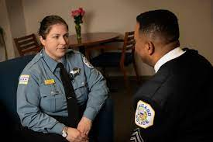
Let’s Practice

Slide 70
BlueLine Support Resources
https://bluelinesupport-bls.org/resources/

Slide 71
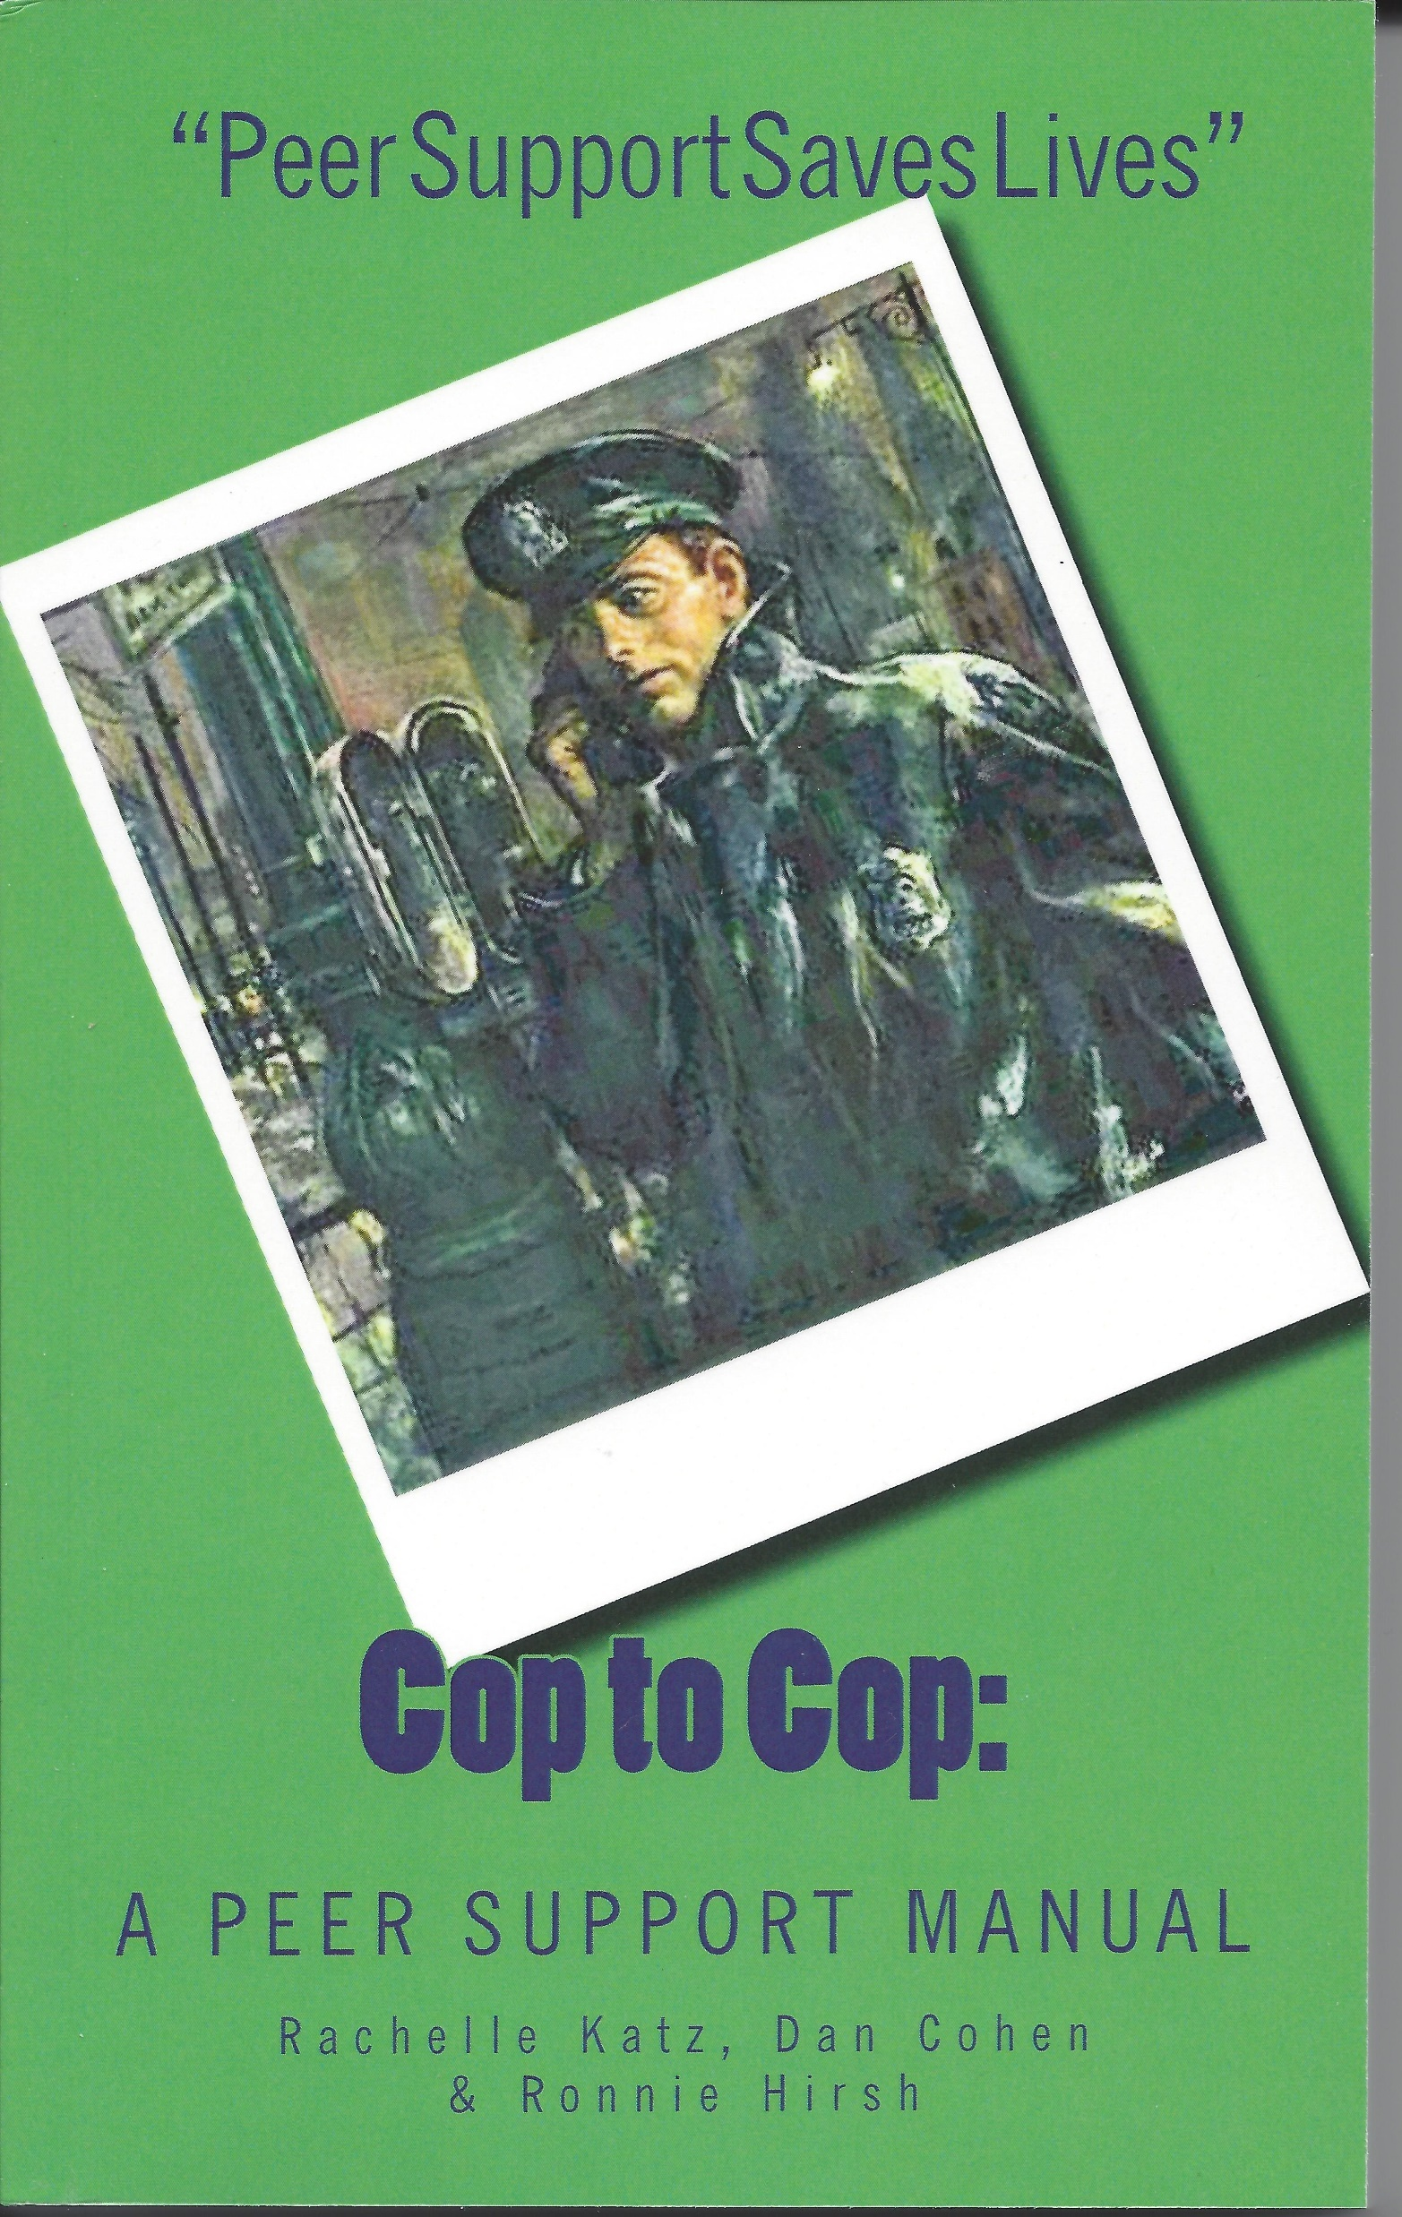
Katz, Rachelle; Cohen, Daniel; Hirsh, Ronnie. (2013). Cop to Cop: A Peer Support Training Manual for Law Enforcement Officers - 3rd Edition. Peer Support Press: New York.

Slide 72
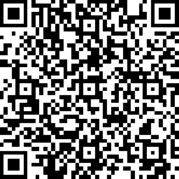
Training Feedback & Recommendations
Comments
Recommendations
Training Survey

Slide 73
2582 MAGUIRE RD, #191 OCOEE, FLORIDA 34761
407•499•5050
www.bluelinesupport-bls.org
855-964-BLUE

Slide 74
Thank you for Attending

